Slide 1
Development of a Standardised Nanopore Bioinformatics Pipeline for Rare Disease
Nour Mahfel
Trainee clinical scientist at Birmingham Women’s Hospital NHS

Slide 2
Content
01
The clinical problem
02
Study design & objectives
03
Project plan
04
Pipeline design
06
Pipeline development
06
Validation
07
Impact, limitations, and next steps

Slide 3
Rare diseases
400M
80%
75%
8,000+
People affected globally
Have a genetic basis
Present in childhood
Described rare disorders
Fewer than 1 in 2,000 individuals per condition
Often pathogenic variants in conserved housekeeping genes
Frequently as neurodevelopmental disorders
New disease genes still being catalogued
30-40%
Diagnostic yield

Slide 4
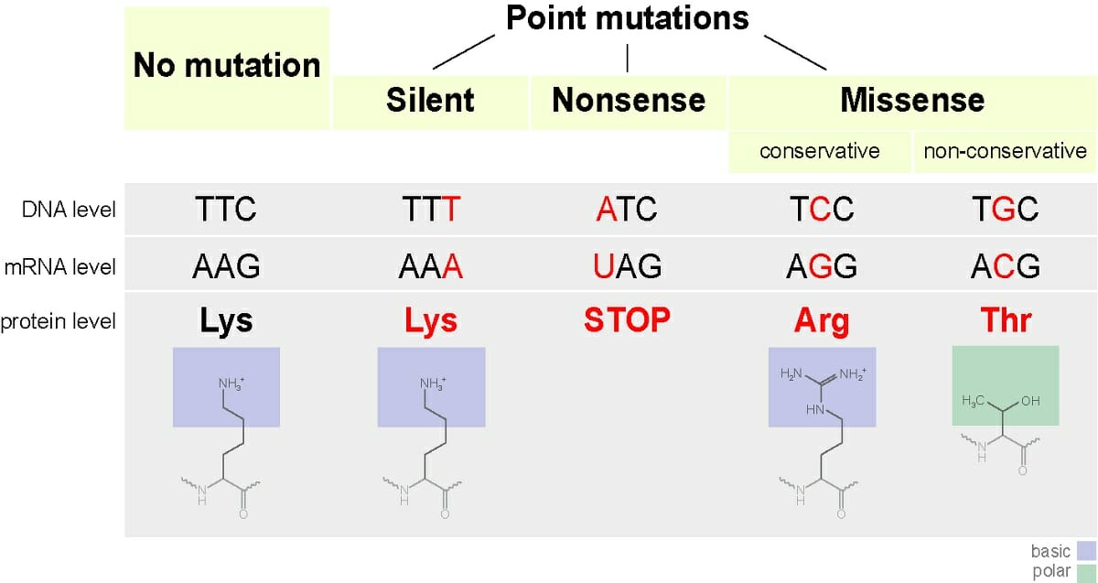
Genetic variation (SNVs)
In the Human Gene Mutation Database, missense and nonsense substitutions account for ~63% of entries, with splicing mutations contributing a further ~8%

Slide 5
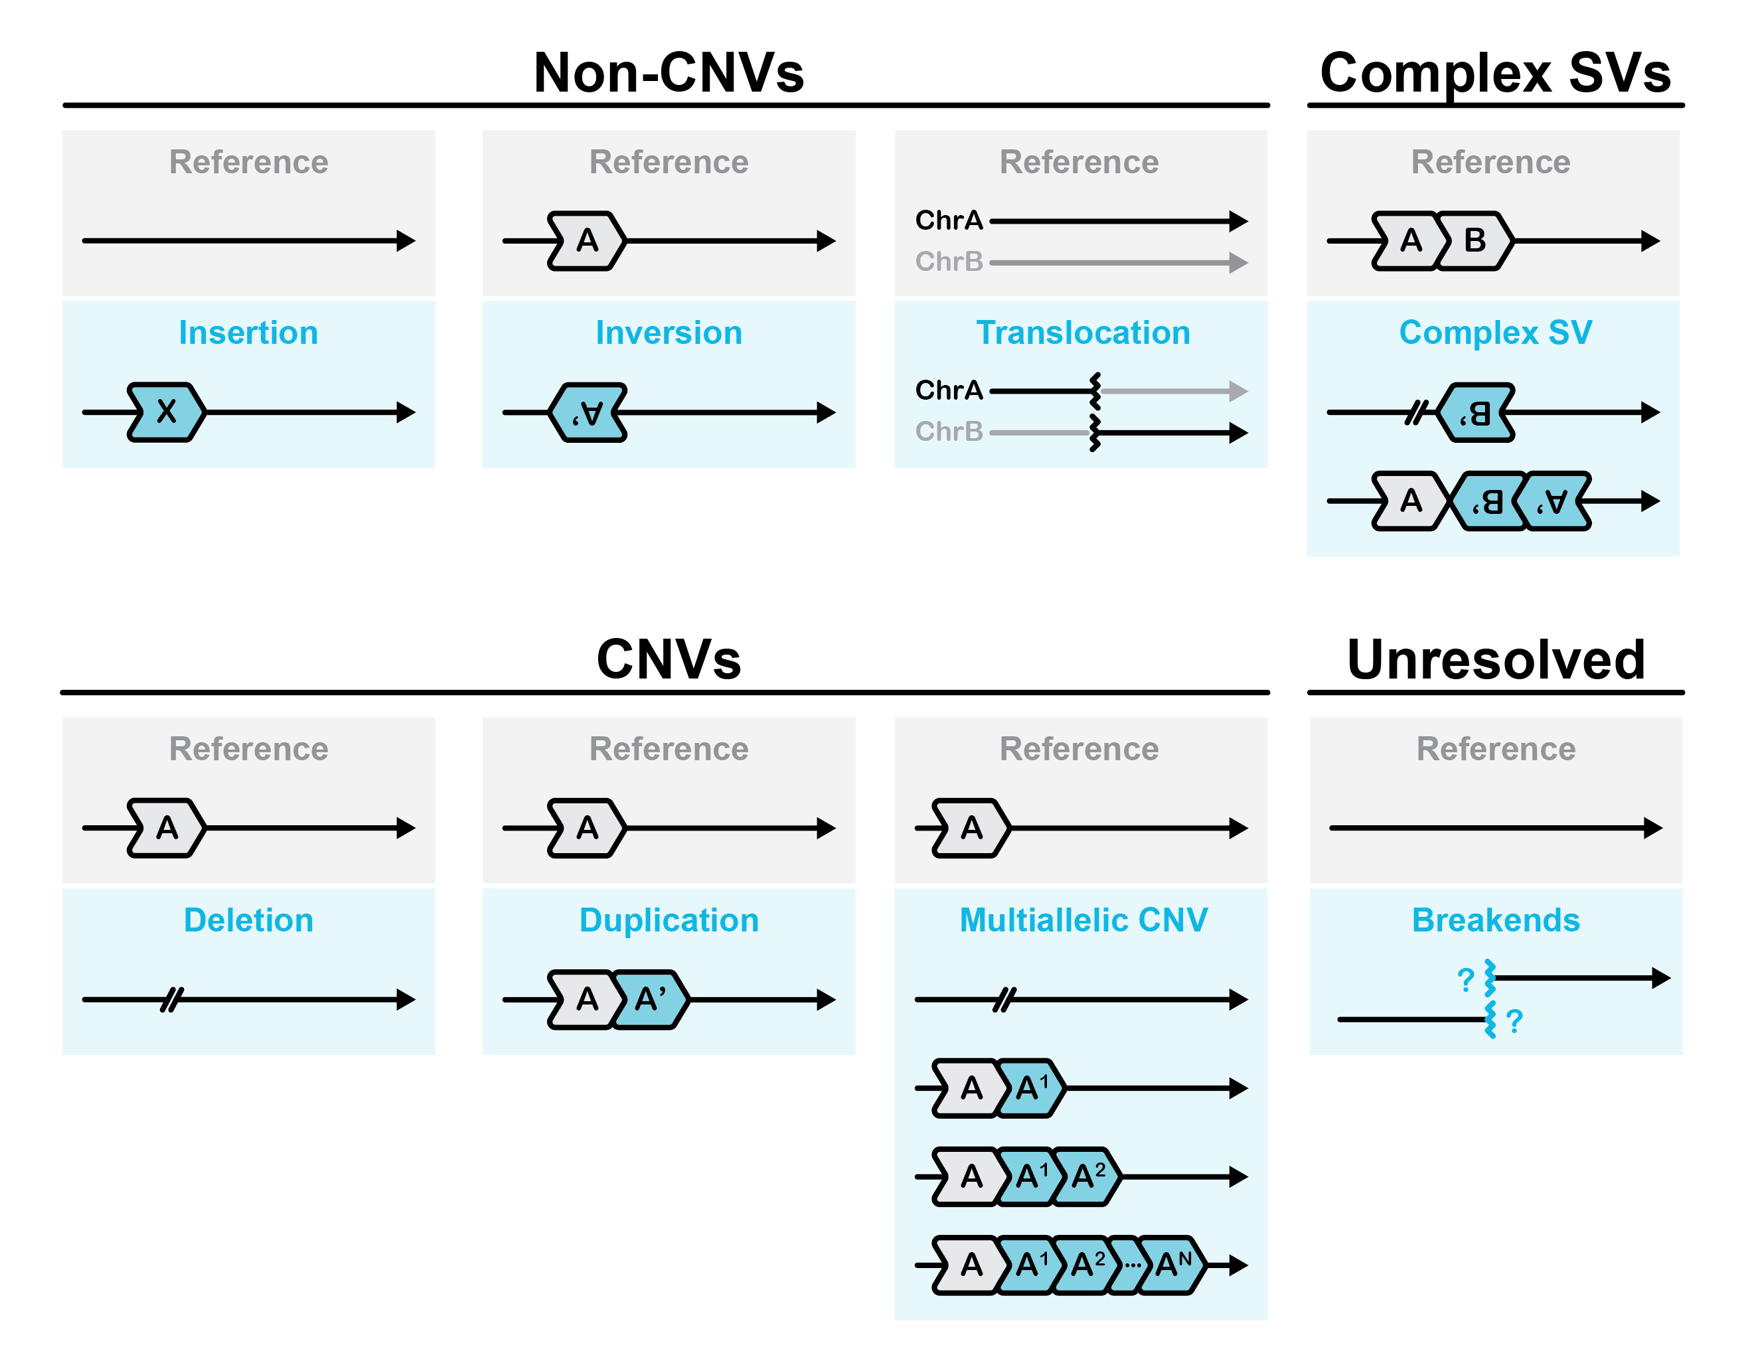
Genetic variation (SVs)

Slide 6
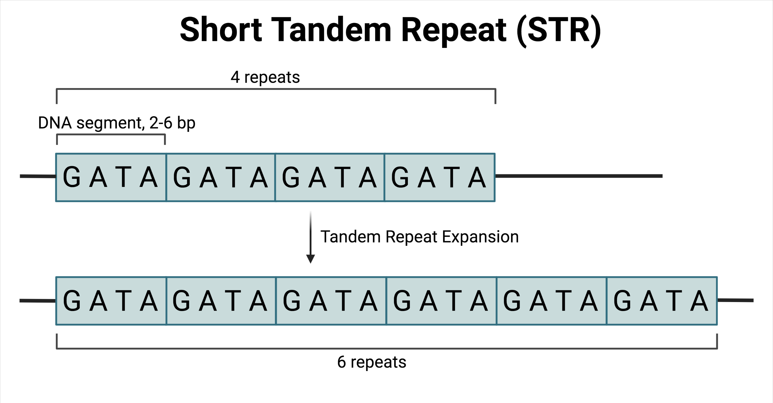
Genetic variation (STR expansions)

Slide 7
Current Diagnostic challenges
SV under-detection
Reads break inside repeats; breakpoints span fragments that cannot be reliably reconstructed
Short-read coverage (~150 bp fragments)
STR expansions hidden
Pathogenic repeat lengths often exceed read length - expansion size cannot be measured
Reads break inside repeats
- cannot span, cannot phase
Phasing is short-range
Reference genome (repetitive region highlighted)
Compound heterozygous cis/trans relationships cannot be resolved across distant variants
Methylation is not captured
Bisulfite conversion or methylation array run in parallel - added cost, coordination, and turnaround

Slide 8
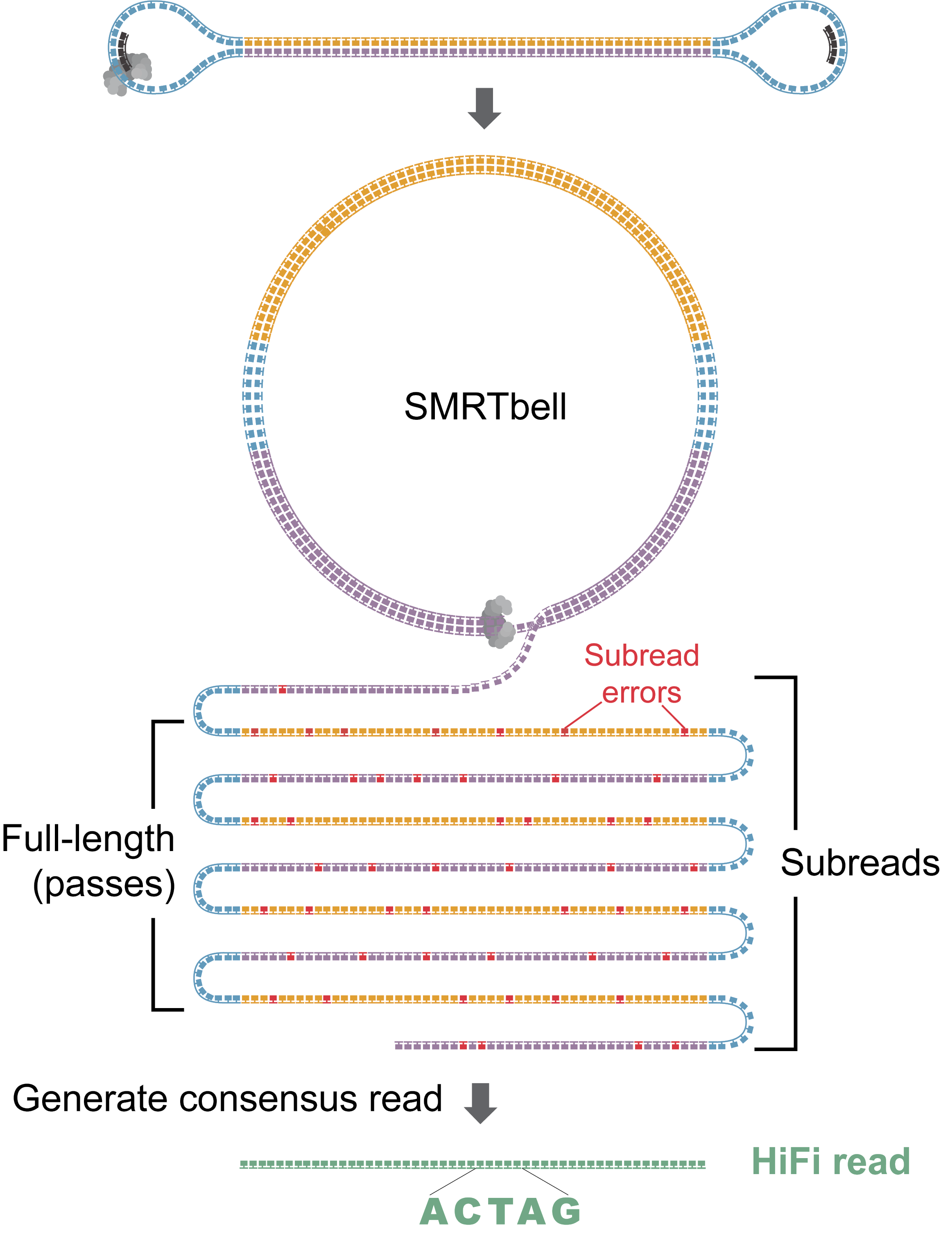
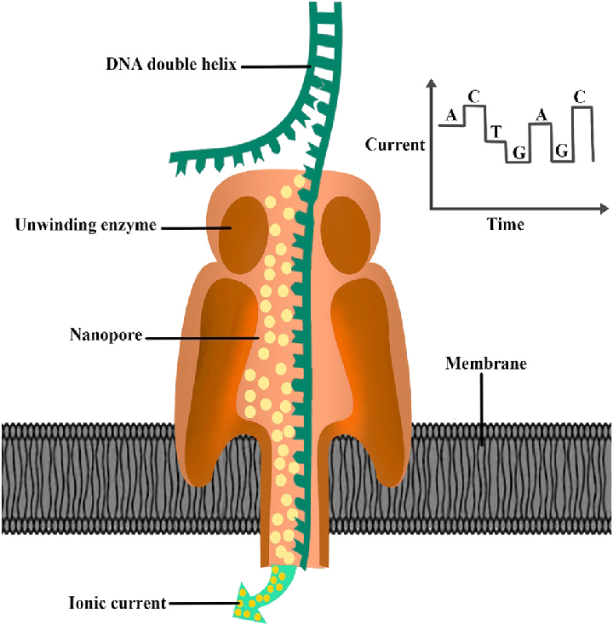
What is long read sequencing?
PacBio
ONT

Slide 9
Advantages of long reads
⟷
Span complex variation
☰
Long-range phasing
~ 20,000 SVs per genome vs ~ 6,000 from SR-WGS
Critical for recessive disease interpretation
∴
Full STR genotyping
⊚
Native methylation
Including interrupting motifs and methylation state
Single library covers sequence and epigenetic analysis
Reported incremental diagnostic yield of LR-WGS in unresolved rare disease: 7-17% above SR-WGS baseline.

Slide 10
Barriers to clinical implementation
Historical barriers
Where we stand now
Sequencing error rate
Largely resolved by new chemistry
Cost per genome
Costs falling, single-assay value growing
Validated bioinformatics pipelines
Peer-reviewed validated tools available
QMS and accreditation investment
Genomics England ONT cancer pilot study

Slide 11
The NEEDED study at WMGL
Study cohort
28
proband + both biological parents
families (trios)
NDD
unresolved neurodevelopmental disorders
phenotypes
All
no molecular diagnosis from NHS GMS testing
prior SR-WGS
3
previously identified
positive controls
REC
15/WM/0076 - Understanding the Genomic Basis for Human Disease
ethics approval

Slide 12
The bioinformatics gap
Research-use script
Selected individual analysis steps only
No containerisation or version pinning
No formal documentation or governance
Dependent on external maintenance

Slide 13
The study objectives
Primary objective
  Establish an in-house pipeline that is reproducible, portable, and auditable
  Quantify diagnostic yield of a long-read pipeline vs the short-read baseline
Secondary objectives
  Conduct cost-benefit analysis: consumables, compute/storage, staff time, TAT, and confirmation burden
  Assess feasibility: sample/coverage requirements and platform fit

Slide 14
Project Aim
Design, develop, validate, and implement a long-read sequencing bioinformatics pipeline applied to the NEEDED cohort within the WMGL quality management system, and evaluate its analytical performance and potential clinical utility for future diagnostic implementation.

Slide 15
The development pathway
URS
Project plan
Establish a Clinical-grade long-read workflow needed for diagnostics

Slide 16
Quality management systems
ISO 15189:2022
DCB 0129 / 0160
CE 25.04.14
Change Enquiry
Clinical safety
Formal governance submitted through the WMGL Suggest & Change application (ChangeApp).
NHS Digital standards for clinical risk management in health IT.
Three interrelated governance components
Specification
Requirements
Options appraisal
Measurable performance criteria: analytical
Functional and non-functional needs of stakeholders
Three candidate approaches compared

Slide 17
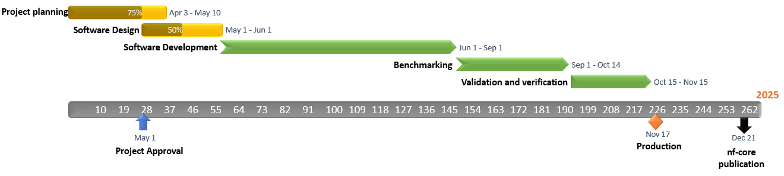
Project plan
Today
2025
2025
Establish project scope and timescale
Conduct a risk assessment
Nov

Slide 18
Options appraisal
Option 1
Option 2
Option 3
✓ SELECTED
No change
Adopt EPI2ME wf-human-variation
In-house nf-core development
Weighted score: 6
Weighted score: 27
Weighted score: 57

Slide 19
Clinical risk assessment
ID
Category
Risk
Mitigation
R1
Internal
Tool version drift
Containerisation + semantic versioning + tag pinning in SOPs
R2
Internal
Incomplete test coverage
nf-test at module/subworkflow/e2e; GIAB benchmark
R3
Internal
Single developer bottleneck
Code review by registered Clinical Bioinformatician
R4
Internal
Scope creep
MoSCoW framework; deferred Could/Won't to future releases
R5
Internal
Data integrity errors
Automated input validation
R6
Internal
Inadequate parameter docs
All non-default params logged with rationale
R7
External
Data breach on HPC
Pseudonymisation; VPN + 2FA; DPIA completed
R8
External
ONT chemistry
Monitor release notes
Outcome: No clinical risks identified that would prevent safe delivery. Risk register maintained as a living document in CE 25.04.14 and reviewed at each sprint retrospective.

Slide 20
The development pathway
URS
Project plan
Software Design
Establish a Clinical-grade long-read workflow needed for diagnostics
Determine the architecture of the long-read pipeline.

Slide 21
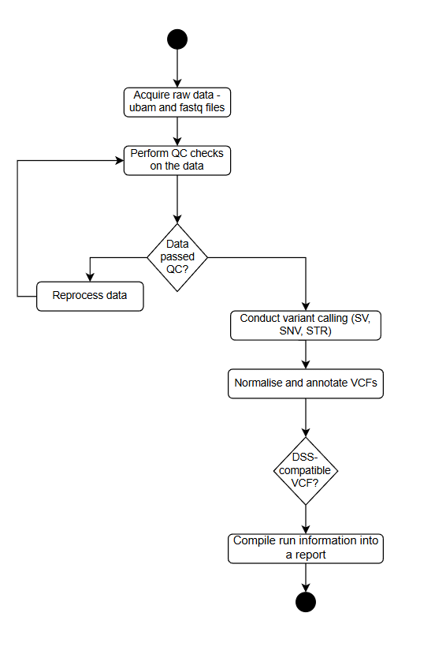


Software Design
The software design was determined during the initial phase.
Key considerations included what input data were available (uBAM/FASTQ), the required outputs, and which VCF formats needed to be compatible with downstream DSS tools.
Follows standard bioinformatics pipeline, but is enhanced to analyse long read sequencing data and uses long read tools

Slide 22
What are Nextflow and nf-core?
Nextflow - the recipe language
nf-core - the curated cookbook
Designed to help build large workflows
Peer-reviewed tools
Steps can run in parallel and resume
Automated tests
Reproducibility, portability, and version control
HPC/Cloud compatibility
In short: Nextflow is the language we write the pipeline in. nf-core is the community that checks it is built to standard and shares it with other labs.

Slide 23
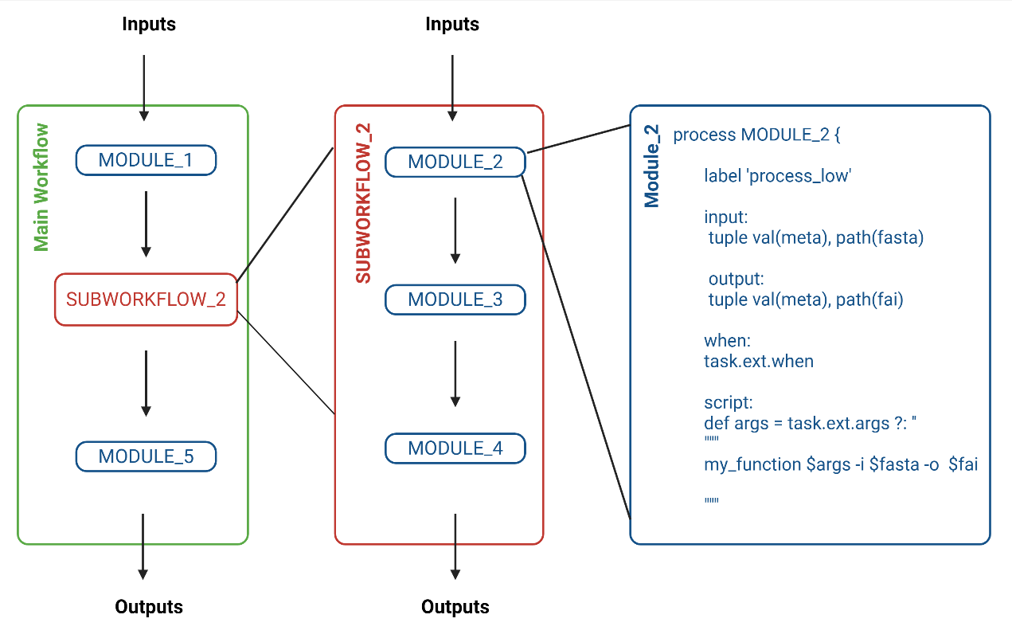
What are Nextflow and nf-core?

Slide 24
Analytical flow
From uBAM/FASTQ input to unified annotated VCF - sequential core, parallel variant branches
SNV / INDEL
INPUT
FASTQ / uBAM
samplesheet
SV
TRIO
OUTPUT
→ SeqOne
PHASE / TAG
BAM
ALIGN
minimap2
→ BAM + MM/ML
CNV
STR
Methylation
Sequential core (align → phase) feeds parallel variant branches (SNV/SV/CNV/STR/methyl), which converge in trio analysis and produce a unified VCF for clinical review.

Slide 25
Multi-caller SV consensus strategy
No single long-read SV caller detects all variant types with equal sensitivity - we run three, then merge
Why multi-caller?
Complementary performance
Published benchmarks show SV callers differ in sensitivity and precision across deletions, insertions, inversions, and duplications.
Higer sensitivity
Missing a pathogenic variant costs a family a diagnosis. Running multiple callers and merging increases overall sensitivity.
Confidence from consensus
Variants supported by multiple callers carry higher confidence than single-caller calls, supporting downstream filtering strategies.
Sniffles2
v2.6.2 · general-purpose, population-scale
CuteSV
JASMINE
MERGED
SV VCF
v2.1.2 · clustering-based, tuned for ONT
v1.1.5 · merge
SVIM
v2.0.0 · alignment-based, complex SV focus

Slide 26
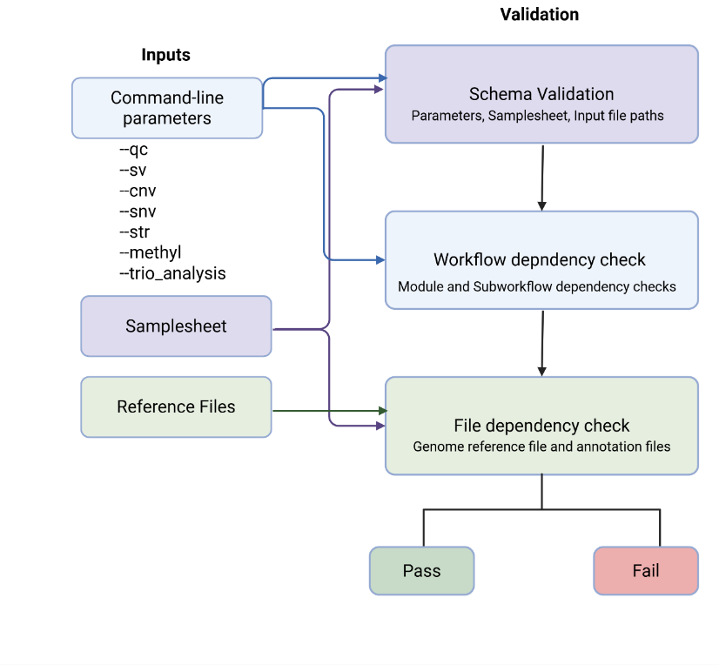
Pre-execution validation framework

Slide 27
The development pathway
Testing profile
Subset HG002
URS
Project plan
Software Design
Pipeline
development
Establish a Clinical-grade long-read workflow needed for diagnostics
Determine the architecture of the long read pipeline.
Develop an nf-core style pipeline.
Write Modules, Subworkflows, Worfklows.

Slide 28
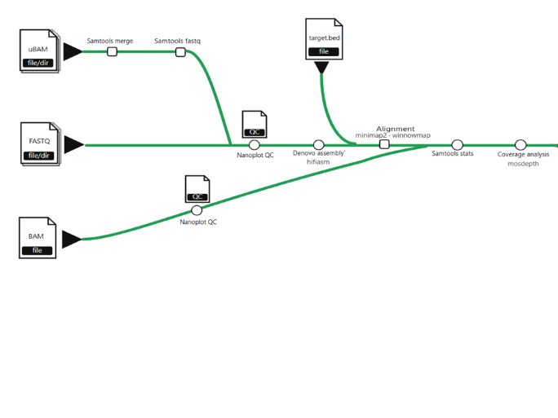
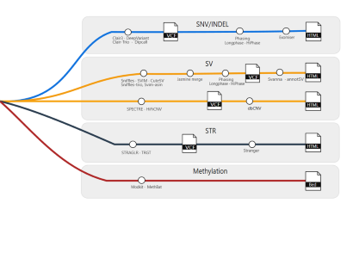
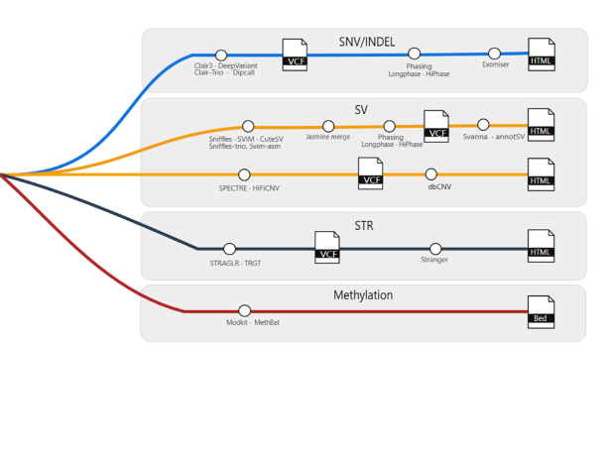

The long read sequencing pipeline

Slide 29
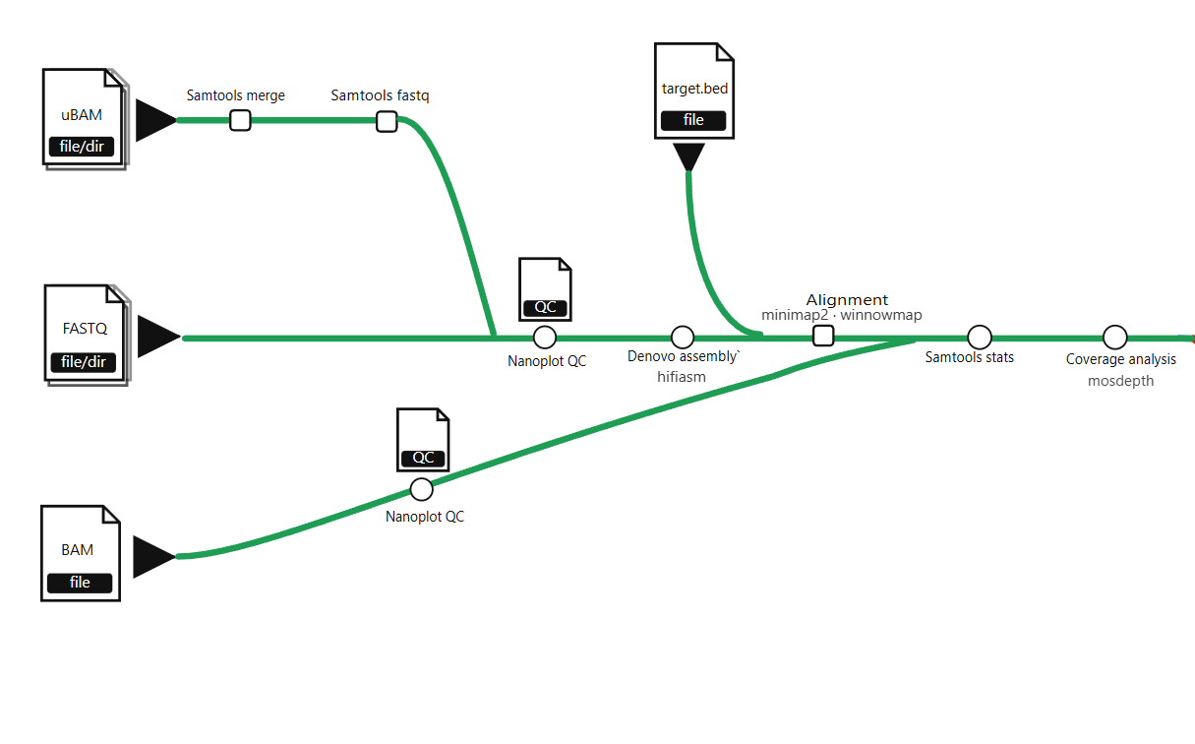

Slide 30
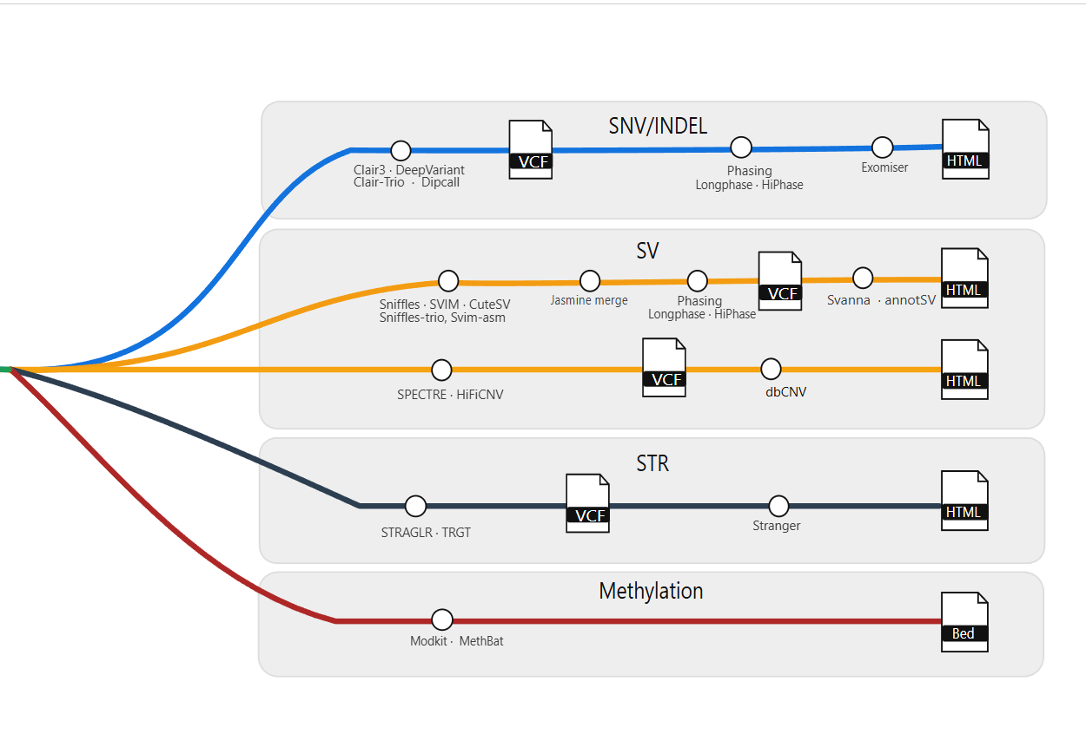

Slide 31
Testing and continuous integration
Test coverage
Module tests
Per-tool unit tests - each wrapper confirmed to execute correctly on a small input
Subworkflow tests
Integration tests verifying channel plumbing and input/output shapes between modules
End-to-end tests
Whole-pipeline runs on chr22 subset: single sample and full Ashkenazim trio

Slide 32
The development pathway
Testing profile
Subset HG002
URS
Project plan
Software Design
Pipeline
development
Validation
Establish a Clinical-grade long-read workflow needed for diagnostics
Determine the architecture of the long read pipeline.
Develop an nf-core style pipeline.
Write Modules, Subworkflows, Worfklows.
Validation runs
Positive controls
Truth dataset

Slide 33
Benchmarking setup
GIAB = Genome in a Bottle, a NIST-led public truth set used to benchmark variant callers
Trio pedigree
Protocol
Raw data
Basecalling with Dorado → uBAM
Processing end-to-end through the pipeline
HG003
father
HG004
mother
Benchmark truth sets
HG002
proband
SV (HG002 only)
SNV/INDEL (all three)
squares = male · circles = female

Slide 34
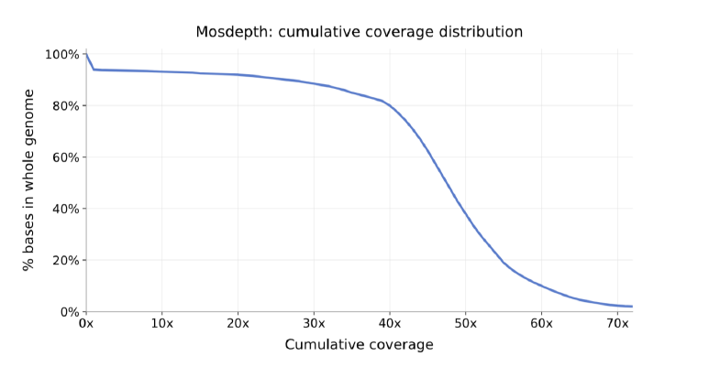
Asheknazim quality analysis
Depth
Coverage in practice
GIAB benchmark trio - target ~40x
What does mosdepth do?
Mosdepth is a fast program that measures depth from aligned reads.
How to read the curves
A curve that stays high until 40x means most of the genome has at least 40x coverage.

Slide 35
SV calling performance
Key findings

Slide 36
SNV and INDEL performance
SNV calling
INDEL calling
F1 ≥ 0.997 across all three samples
Lower and more variable - HG002 F1 0.848
Why INDELs are harder for ONT. Nanopore signals in homopolymer regions produce extended, less distinct ionic currents - making it difficult to resolve the exact number of repeated bases. R10.4.1 dual-reader chemistry improved this but residual homopolymer error remains.

Slide 37
Trio concordance

Slide 38
Trio concordance
Repeat-rich context
SVs concentrate in repetitive and segmentally duplicated regions where read mapping is ambiguous
No canonical SV representation
Same rearrangement can be recorded with different start coordinates, SV types, or allele lengths - caller dependent
Complex classes genotyped less accurately
Inversions and large duplications carry more residual genotyping uncertainty than SNVs
Matches published expectations
~15% Mendelian inconsistency

Slide 39
Computational performance
Alignment dominates runtime; median total trio processing on BEAR is ~ 20 hours
~ 20 h
~ 8 h
32 × 64
40 ×
Median trio runtime
Alignment per genome
CPUs × GB memory
Mean coverage
end-to-end uBAM → annotated trio VCF
minimap2, 32 CPUs, 64 GB memory
per module allocation on BEAR
achieved across all cohort families
minimap2 (alignment)
60%
SV callers (parallel)
15%
Clair3 (SNV/INDEL)
12%
Annotation + merge
5%
QC + methylation + STR
5%
Trio analysis
3%
Research-acceptable today. For clinical turnaround, GPU-accelerated alignment or alignment within ONT instrument would be a more suitable approach.

Slide 40
Positive control validation
Three families with previously confirmed diagnoses - all three pathogenic variants successfully recovered
✓ 100% recovery of known diagnostic variants
Family 1
Family 2
Family 3
SMARCB1
RNU4ATAC
APC
c.1084_1086del p.(Glu362del)
n.13C>T + n.48G>A
c.730-494C>G
De novo
Compound het (mat + pat)
Heterozygous
Coffin-Siris syndrome
RNU4ATAC-related disorder
Familial adenomatous polyposis

Slide 41
The development pathway
Testing profile
Subset HG002
URS
Project plan
Software Design
Pipeline
development
Validation
Pipeline deployment
Establish a Clinical-grade long-read workflow needed for diagnostics
Determine the architecture of the long read pipeline.
Develop an nf-core style pipeline.
Write Modules, Subworkflows, Worfklows.
Validation runs
Positive controls
Truth dataset
Pipeline accepted to be published on nf-core and used internationally.

Slide 42
Impact and outcomes
From internal research tool to community-reviewed open-source pipeline
Technical
⎔
Open source
Pipeline delivered
On GitHub
Repository
nf-core/longraredisease
Clinical
Status
v1.0.0dev (release PR #38 open)
Outputs for review
Framework
Nextflow DSL2 ≥ 25.04
Standards
nf-core 3.4.1
Licence
MIT (open-source)
Community
Published on nf-core
github.com/nf-core/longraredisease

Slide 43
Limitations
What to keep in mind
What works well
Fewer variants when callers must agree
DSS compatibility
Captures all variant classes
Translocations (BNDs) not detected equally
Only three positive controls
Transparent, auditable, open

Slide 44
Future directions
Apply to remaining cohort Process 15 additional trios in preparation for sequencing; multidisciplinary review of candidates for publication as a formal diagnostic yield study.
Alignment optimisation NVIDIA Parabricks Minimap2 (GPU-accelerated) as a near-term target to reduce the 8-hour alignment bottleneck and meet clinical turnaround times.
De novo assembly integration Hifiasm-style haplotype-resolved assemblies improve INDEL calling in homopolymers and SV resolution; convergence on consensus reduces alignment-level artefacts.
Platform-agnostic extension Extend pipeline to PacBio HiFi data. A single governed workflow across UK GMS platforms would simplify cross-site analytical comparison and accreditation.

Slide 45
Thank you
Questions welcome
ACKNOWLEDGMENTS
WMGL supervision
University & collaborators
NEEDED study
Chipo Mashayamombe-Wolfgarten, PhD
Natalie Borrows
Joe Larkman
Dr Michael Cornell
Dr Helen Hulme
Andrew Devereau
Rike Hanssen
Dr Hannah Titheradge
Professor Andrew Beggs
Lorraine Hartles-Spencer
Danielle Morris

